Slide 1
Pet Store Management System

Slide 2
Group Members
Muhammad
Bilal
Hurmat Ilyas
Kiran Zafar
Mercury
Areeba Rashid
Neptune
Inayat Ullah
Venus
Mars

Slide 3
Introduction
Pet store is designed to provide facilitation to the pet lovers as they can buy pets of their choice by sitting home. It is a user friendly application. It includes the categories of cats, dogs & birds. Description, price, weight, image and location of the pets are added in this store. It recommends the pets which are nearby based on location of buyer.

Slide 4
Mission Statement
Our mission is to provide a platform for pet lovers where they can buy and sell pets online across the country.

Slide 5
Mission Objectives
To maintain (enter, update and delete) data on Admin, Seller, Buyer & Pets/Pets detail
01
02
To provide web based interface to user to manage his activities
03
To provide an option for storing and managing the basic information about pets
04
To provide an option for storing and managing the basic information about customers

Slide 6
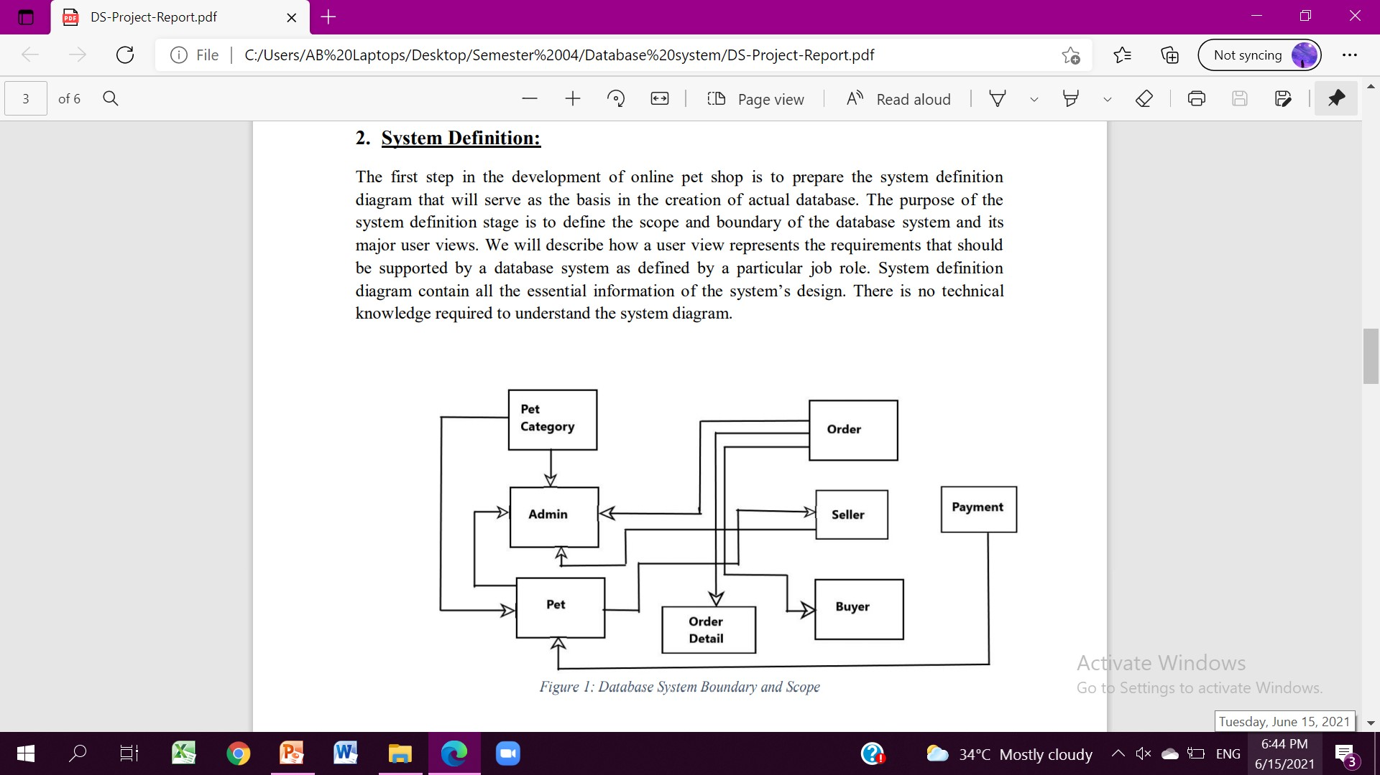
System Definition

Slide 7
System Requirements
The types and average number of record searches
Security
Initial database size
Database rate of growth
Performance
Networking and shared access requirements
Backup and recovery
Legal issues

Slide 8
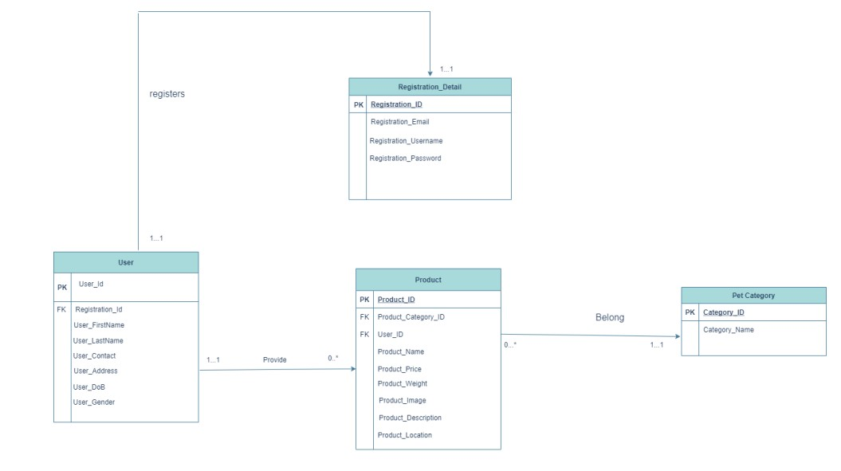
Entity Relationship Diagram

Slide 9
Achievements
User-friendly Application
Add/Delete details about pets and users
Login system with password protection
Location-based pets recommendation
Storing and managing the basic information about pets
Storing and managing the basic information about users

Slide 10
T
H
A
N
K
Y
O
U

